Slide 1



Slide 2

ABOUT US
HiQuSystems (Pvt) Ltd. is fully owned subsidiary of a NYC based commercial software company Nexelus, Inc.
Was established in 2002 as the offshore development center for Nexelus products.
Provides support services to Nexelus’s clients in USA, Canada, UK, France and Spain.

Slide 3




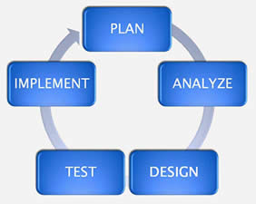
OUR VALUE SYSTEM
ETHICS
COLLABORATION
EXCELLENCE
THINKING THINGS THROUGH

Slide 4

CORPORATE CULTURE
Identify, attract and groom new talent
Relaxed but quality deliverable oriented
Team oriented environment

Slide 5
WHAT WE HAVE TO OFFER
Work in a commercial product company that collaborates with companies like Google and Microsoft
Learn and excel with the latest software development technologies - .NET, mobile apps, high volume transaction processing database technology
Focused on your professional growth
Be part of fast growing company (30% in last 12 months)

Slide 6
CORPORATE CULTURE
Equal Employment Opportunity:
HiquSystems provides Limited promises equal opportunities to all the stakeholders and treat them with dignity. All decisions about eligibility, qualification, and selection of applicants will be based on merit. No discrimination to be made based on disability, community, race, or gender.
Open Door Policy:
At HiquSystems, every manager's door is open to every employee. The purpose is to encourage open communication, feedback, and discussion about any matter of importance to an employee. Employees can take their workplace concerns, questions, or suggestions outside their own chain of command without worrying.

Slide 7
Employee Succession Planning
Trainings:
Training and onboarding of an employee to perform the tasks required for his or her current role.
Career Planning:
An employee-centered practice of identifying the interests of the employee and assisting that individual, as well as providing personal development options consistent with his or her talents and interests.
Career Management:
An organization-centered practice of creating jobs and organizational structures that promotes the achievement of business objectives.
Succession Planning:
The future-focused practice of identifying the knowledge, skills and abilities to perform certain functions and then developing a plan to prepare multiple individuals to potentially perform those functions.

Slide 8
Employee Development Plan
Increased duties and responsibilities:
Employee are encouraged to learn and help incorporate new technology, systems, and processes and train team members on them. Alternatively, employees may take on more challenging responsibilities to help them advance in their roles.
Professional organizations and seminar participation:
Encourage employees to attend conferences and workshops, or coordinating events sponsored by the organization. These events offer opportunities for employees to network and take on a more active role in their organization and industry.
Continuing education courses:
For employees interested in pursuing a higher degree or certification to help them win a promotion opportunity.

Slide 9

Management is based on collaboration between New York and Islamabad based resources

Slide 10

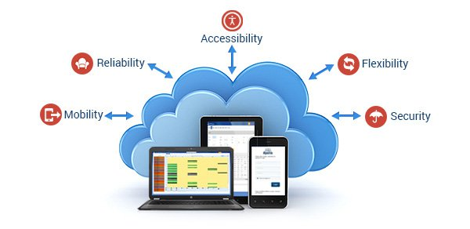
Cloud Based Operational Software
for Digital Agencies
Cloud Based Operational Software
for Digital Agencies

Slide 11
Cloud Based Operational Software
for Digital Agencies
Through our cloud based technology we enable agencies to do more with less by implementing our best practices platform across various disciplines thus increasing their margins

Slide 12

PLATFORM
Dashboards
Call-to-action
Business
Intelligence
KPI’s
Project & Resource Management
Digital Media
Agency Operational & Financial Management Platform

Slide 13
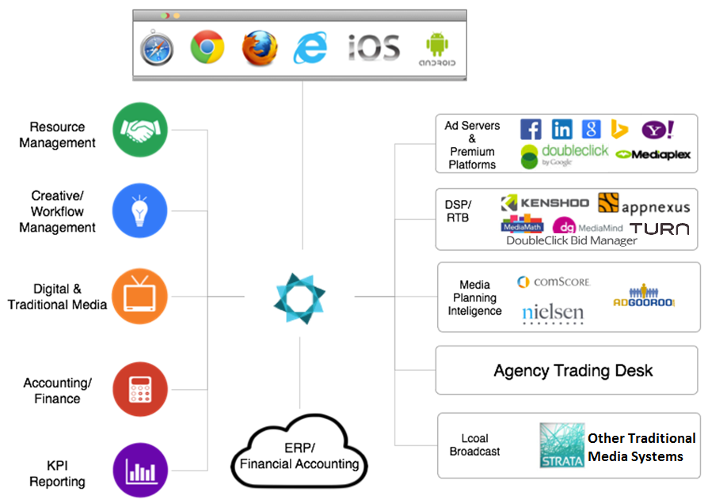
TECHNOLOGY INTEGRATIONS

Slide 14

BENEFITS
Visibility: Revenues are growing but margins are shrinking – Nexelus helps to identify and rectify the issue
Flexibility: Flexible/Configurable “platform” to address different needs across offices and accounts
Best Practices: Adapts to current culture while standardizing processes across global offices “Crawl-Walk-Run”
Retainer/Project Health: Real-time information on where to invest or divest – early detection of over servicing and/or scope creeps
Capacity Planning/Talent Management: Information to proactively plan whether or not more or fewer resources are needed to deliver the work

Slide 15

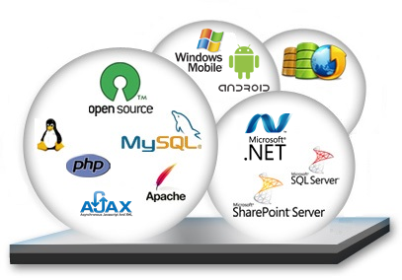
Development Tools and Technologies
We use C#.Net, ASP.Net, Ajax, JSON, WebService, MS SQL Server, etc.

Slide 16


CAREER OPPORTUNITIES
We are an equal opportunity employer and offer lucrative salary packages and benefits, such as Provident Fund, EOBI, Medical, etc to skilled and committed employees.

Slide 17

Mr. Imran Rahman - CEO
Mr. Arshad Sadal - General Manager
Mr. Tauseef Shahzad - General Manager Development
Ms. Asiya BB - HR Manager

Slide 18








Thank You

